Slide 1
RDBES Effort (CE) and landings (CL) tables
Presentation by Josefine Egekvist, DTU Aqua, Denmark for WKRDBES-INTRO2 2023
Updated for WKRDBES-INTRO3 2024 and presented by Kirsten Birch Håkansson, DTU Aqua

Slide 2
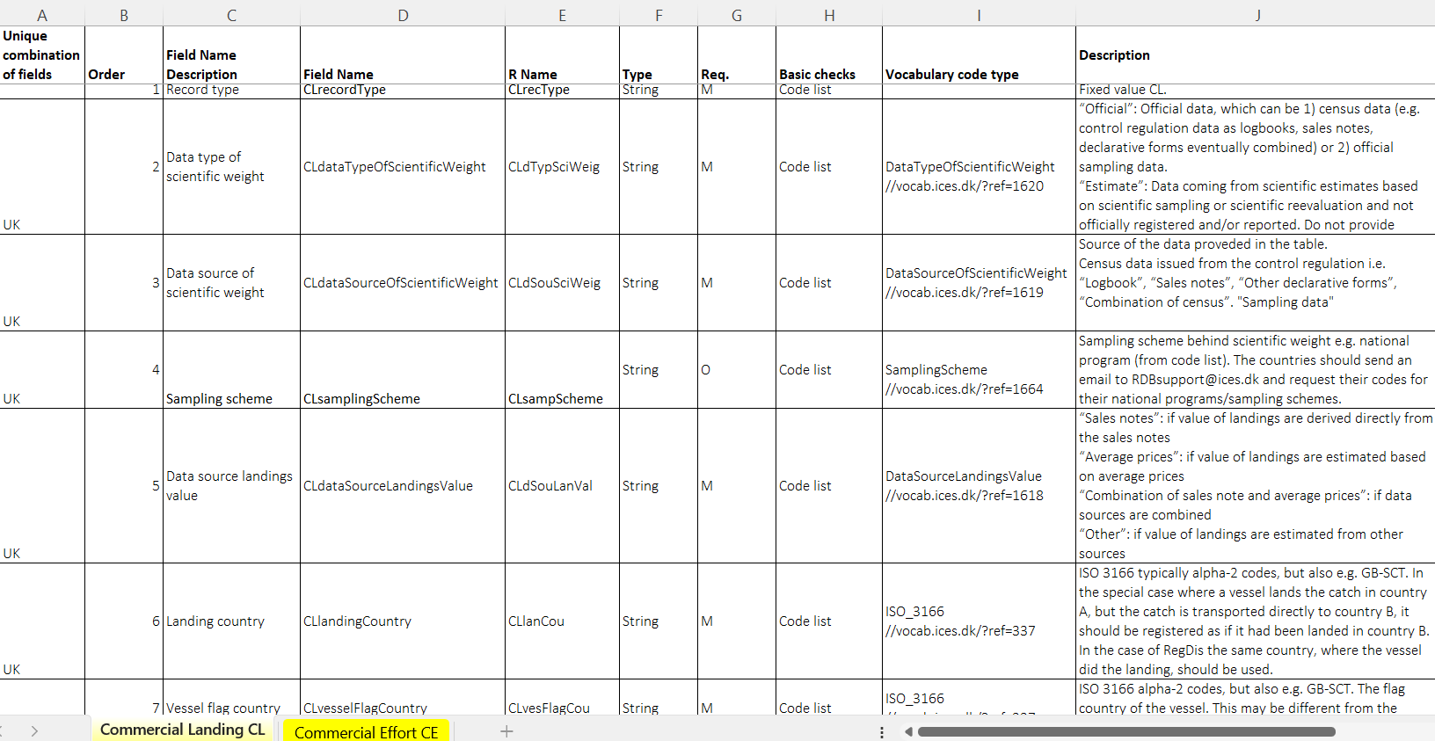
Data format description and documentation
CL=RDBES Commercial landings data
CE=REBES Commercial effort data
Description of the format can be found at:
https://github.com/ices-tools-dev/RDBES/tree/master/Documents
Data format specification:
RDBES Data Model CL CE.xlsx, Cells with changes to the format are marked with yellow
Documentation:
RDBES Documentation of the Data Model.docx,
Note: use codes in the ICES Vocabulary (https://vocab.ices.dk/), the ones in the format description are examples. Links to ICES vocabulary can be found in the Vocabulary Code Type field.
Filenames should have the suffix CL or CE

Slide 3
Updates in the 2024 data call
The FDI variables are now a part of the unique key
CL official weight was made optional (it will turn mandatory for next data call)
CE Official days at sea and Official fishing days were made optional
Minor updates of names and descriptions

Slide 4
Principles in the CL and CE data formats
The ICES data center and the RDBES core group have worked on developing the format with inputs from other experts
It is possible to report both official and scientific estimates of landings and effort
Effort calculations should follow recommendations from 2nd Workshop on Transversal Variables in Nicosia https://data.europa.eu/doi/10.2788/042271
Extra optional fields have been included in the RDBES that should make it possible to use the data to consider future ICES data needs and preferably also the STECF FDI data call

Slide 5
Calculation of effort
Effort calculations should follow recommendations from 2nd Workshop on Transversal Variables in Nicosia https://data.europa.eu/doi/10.2788/042271
Examples on how to calculate can be found in the section ‘Fields in Commercial Effort (CE) data format’ in RDBES Documentation of the Data Model.docx
RCG ISSG on Metier and transversal variables are working on updating the R-script developed to calculate fishing effort (fecR). It is available on: http://dcallnet.jrc.ec.europa.eu/gitlab/r-packages/fecR.git
Chairs: Josefine Egekvist (jsv@aqua.dtu.dk) and Sébastien Demaneche (sebastien.demaneche@ifremer.fr)

Slide 6
Metier 6 fishing activity
In need of help, then the RCG ISSG on Metier and transversal variables are working maintaining métier list, other reference lists, script and guidelines. Allocation of métier codes to transversal data should be aligned between data calls (RDBES, EU FDI, ICES VMS/Logbook)
Chairs: Josefine Egekvist (jsv@aqua.dtu.dk) and Sébastien Demaneche (sebastien.demaneche@ifremer.fr)
https://github.com/ices-eg/RCGs/tree/master/Metiers

Slide 7
Official vs. scientific effort and landings
From the data uploaded, we can see that the option to distinguish between official and scientific effort and landings have not been used, therefore a subgroup with RDBES core group and ICES WGCATCH members has discussed the use of official vs scientific effort and landings.
The scientific landings and effort is the best scientific estimate of landings and effort, and will be used for stock assessment etc.
Official landings will be used to assess data completeness and to know how much they differ from scientific estimates.
Official landings will be used by the RCG, e.g., as input to RWP/NWP table 2.1.
CLofficialWeight | CLscientificWeight
CEofficialDaysAtSea | CEScientificDaysAtSea
CEofficialFishingDays | CEscientificFishingDays
CEofficialkWDaysAtSea | CEscientifickWDaysAtSea
CEofficialkWFishingDays | CEscientifickWFishingDays
CEOfficialkWFishingHours | CEscientifickWFishingHours
CEofficialNumberOfHaulsOrSets | CEScientificNumberOfHaulsOrSets
CEofficialSoakingMeterHour | CEscientificSoakingMeterHour
CEofficialVesselFishingHour | CEscientificVesselFishingHour

Slide 8
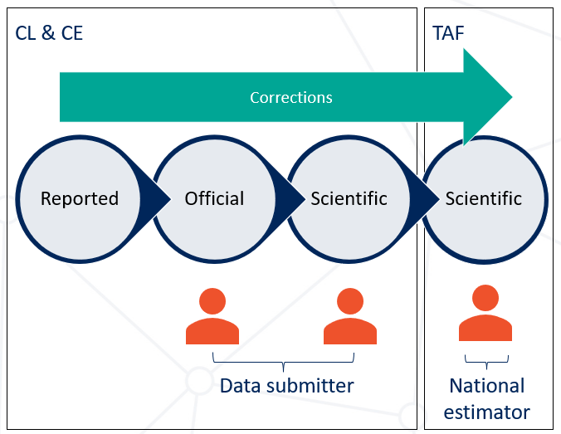
Official vs. Scientific values in CL and CE
- What is it exactly?
The scientific landings and effort are the best scientific estimates of landings and effort, and will be used for stock assessment etc., but whatever these equal the scientific values in the CL and CE is another question?
Corrections can be done by multiple organizations and in multiple places in the process from reported, over official to scientific values
Corrections require different additional data, e.g., VMS and samples data, which may not be available within the RDBES
Different affiliation of the data submitters
  Administration uploads CE and CL directly, without possibility for scientific input.
  Collaboration between ministry and scientific institutes on the best combined database, and all data are reported from that.
  Official data are transferred to the scientific institutes that combines data and submit for CE and CL.

Slide 9
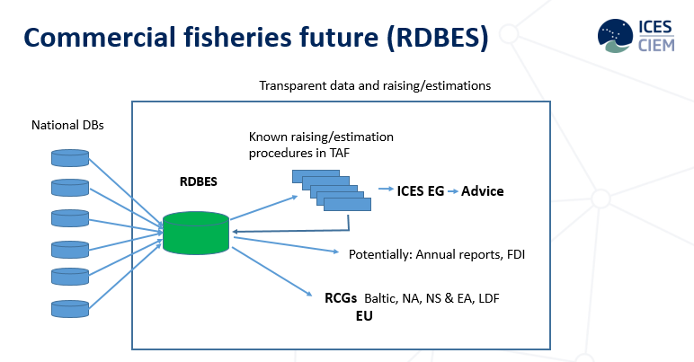
Official vs. scientific effort
- Some guidance
Documentation of corrections in TAF
Scientific values available in CL & CE
Corrections should as far as possible be done, and thereby documented, within TAF
Corrections before submission should be documented elsewhere (Template under development)
For effort data, official effort can be considered what is reported in logbooks, and scientific effort can in general be what is estimated based on other data sources e.g., sales notes, position data etc.
This means that scientific estimates for e.g., stock assessment, still need to go through a national estimator and can not be taken directly from the CL and CE.
It may be difficult for AWG’s and RCG to use the scientific values in CL and CE directly

Slide 10
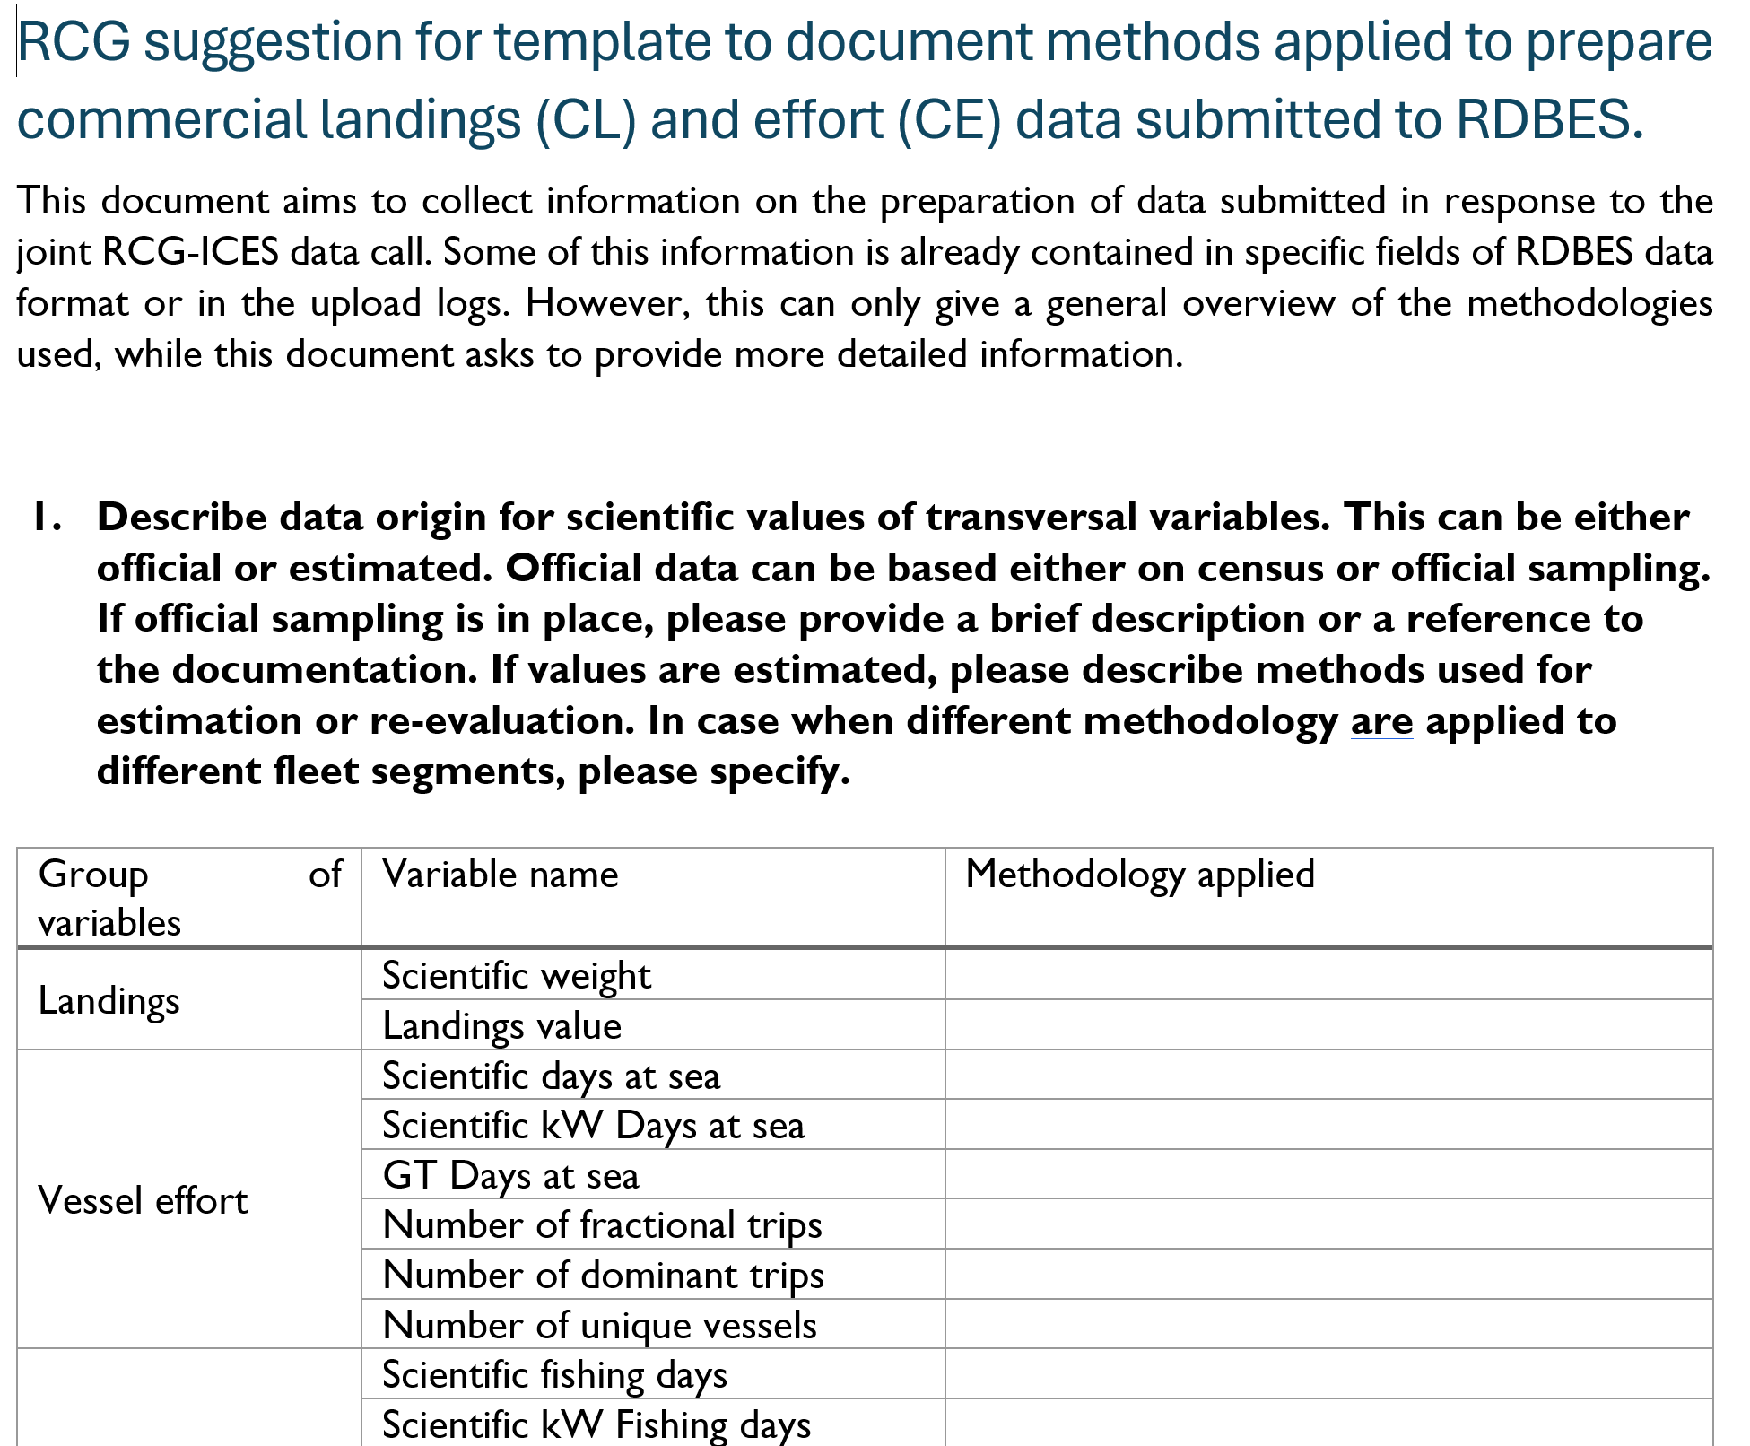
Official vs. scientific effort
- Some guidance
A template suggested by NANSEA&Baltic and up for review by ISSG SSF, ISSG ETP, ICES WGCATCH and ICES WGBYC, and then WGRDBESGOV
A template for documenting the methodologies used for estimation and correction of official and scientific values

Slide 11
Official vs. scientific effort and landings
Example of use of scientific effort
Effort field | Official effort where logbook is available | Official effort where logbook is not available | Scientific effort where logbook is available | Scientific effort where logbook is not available
Days at sea (M) | Logbook arrival time – departure time divided by 24 and rounded up to integer | 0 | Logbook arrival time – departure time divided by 24 and rounded up to integer | Based on sales notes. 1 sale note (vessel id+date) = 1 day at sea
Fishing days (M) | Logbook number of catch dates | 0 | Logbook number of catch dates | Based on sales notes. 1 sale note (vessel id+date) = 1 fishing day
Number of hauls/sets (O) | Based on logbook registration of hauls if reported. |  | Based on logbook registration of hauls if reported. If logbooks are available but not reported by haul, it is set to 1 for each logbook id+catch date+ICES rectangle. | If logbooks are not available (SSF) the scientific number of hauls are set to 1 for each sales note (vessel id+date)
Vessel fishing hour (O) | If logbook reporting is by haul, the official vessel fishing hour can be calculated from start and end of haul time. |  | If logbook reporting is by haul, the official vessel fishing hour can be calculated from start and end of haul time. | If position data are available (VMS/AIS/EM) the fishing hours can be estimated using e.g., a speed filter.
Soaking meter hour (O) | If total net length and soaking time is reported in the logbooks, the soaking meter hour can be calculated. |  | If total net length and soaking time is reported in the logbooks, the soaking meter hour can be calculated. | If high-resolution position data are available (AIS/EM), methods can be developed to estimate net length and soaking time (see ICES WKSSFGEO2).

Slide 12
Official vs. scientific effort and landings
Example of species corrections that can be reported in CL
Anglerfish
Smooth-hounds
This should be done within TAF for proper ducumentation
CLdataTypeOfScientificWeight | CLdataSourceOfScientificWeight | CLsamplingScheme | CLspeciesCode | CLspeciesFaoCode | CLofficialWeight | CLscientificWeight | CLexplainDifference
Estimate | Sampld | Lophius sampling | 126555 | MON | 0 | 750 | Species
Estimate | Sampld | Lophius sampling | 126554 | ANK | 0 | 250 | Species
Official | Saln |  | 125802 | MNZ | 1000 | 0 | Species
CLdataTypeOfScientificWeight | CLdataSourceOfScientificWeight | CLsamplingScheme | CLspeciesCode | CLspeciesFaoCode | CLofficialWeight | CLscientificWeight | CLexplainDifference
Official | Saln |  | 105821 | SDS | 750 | 0 | Species
Official | Saln |  | 105822 | SMD | 250 | 0 | Species
Estimate | ExpertEval |  | 105732 | SDV | 0 | 1000 | Species

Slide 13
Official vs. scientific effort and landings
Example: Stock splitting
Stock splitting before submission to AWG, e.g., Norwegian spring-spawning herring
As today, national estimators will be responsible for the stock splitting. The stock splitting should be done, and documented, in TAF. The RDBES CL do not support information about stock.
Stock splitting within AWG, e.g., Western Baltic spring-spawning herring
Stock coordinator will be responsible for the stock splitting. The stock splitting should be done, and documented, in TAF.

Slide 14
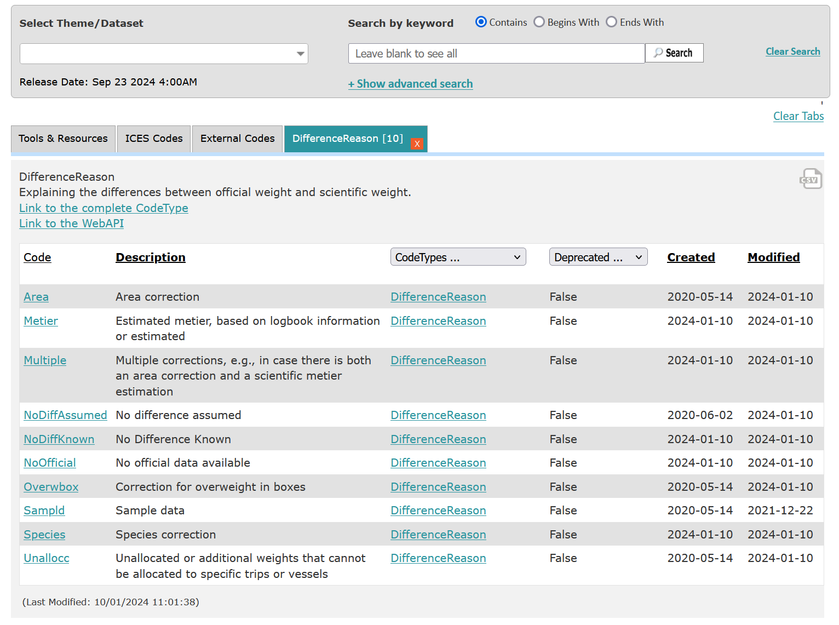
Official vs. scientific effort and landings
In the field ‘DifferenceReason’ in CL there are different options to specifiy the reason for a difference between official and scientific landings.

Slide 15
Overwriting rules
- Beware
Unique combination of fields | Field Name Description | Field Name
UK | Data type of scientific weight | CLdataTypeOfScientificWeight
UK | Data source of scientific weight | CLdataSourceOfScientificWeight
UK | Sampling scheme | CLsamplingScheme
UK | Data source landings value | CLdataSourceLandingsValue
UK | Landing country | CLlandingCountry
UK | Vessel flag country | CLvesselFlagCountry
UK | Year | CLyear
UK | Quarter | CLquarter
UK | Month | CLmonth
UK | Area | CLarea
UK | Statistical rectangle | CLstatisticalRectangle
UK | Fisheries management unit | CLfisheriesManagementUnit
UK | GSA subarea | CLgsaSubarea
UK | Jurisdiction area | CLjurisdictionArea
UK | Fishing area category | CLfishingAreaCategory
UK | Fresh water name | CLfreshWaterName
UK | Exclusive Economic Zone (EEZ) | CLexclusiveEconomicZone
UK | Species code | CLspeciesCode
UK | Landing category | CLlandingCategory
UK | Catch category | CLcatchCategory
UK | Logbook registered discard category | CLregDisCategory
UK | Commercial size category scale | CLcommercialSizeCategoryScale
UK | Commercial size category | CLcommercialSizeCategory
UK | National fishing activity | CLnationalFishingActivity
UK | Metier 6 fishing activity | CLmetier6
UK | Incidential by catch mitigation device | CLincidentalByCatchMitigationDevice
UK | Landing location | CLlandingLocation
UK | Vessel length category | CLvesselLengthCategory
UK | Fishing Technique | CLfishingTechnique
UK | Mesh size range | CLmeshSizeRange
UK | Supra Region | CLsupraRegion
UK | Geographical indicator | CLgeoIndicator
UK | Specific conditions to technical measures | CLspecificConditionsTechnical
UK | Deep Sea Regulation | CLdeepSeaRegulation
“Commercial Landing and Effort data
For data corrections for Commercial Landing and Effort data, data will be overwritten with the latest data upload with a combination of all the key fields:
See all key fields for CL and CE”
To be on the safe side, then delete before updating
UK | Record type | CErecordType
UK | Data type of scientific effort | CEdataTypeOfScientificEffort
UK | Data source of scientific effort | CEdataSourceOfScientificEffort
UK | Sampling scheme | CEsamplingScheme
UK | Vessel flag country | CEvesselFlagCountry
UK | Year | CEyear
UK | Quarter | CEquarter
UK | Month | CEMonth
UK | Area | CEArea
UK | Statistical rectangle | CEStatisticalRectangle
UK | Fisheries management unit | CEfisheriesManagementUnit
UK | GSA subarea | CEgsaSubarea
UK | Jurisdiction area | CEjurisdictionArea
UK | Fishing area category | CEfishingAreaCategory
UK | Fresh water name | CEfreshWaterName
UK | Exclusive Economic Zone (EEZ) | CEexclusiveEconomicZone
UK | National fishing activity | CEnationalFishingActivity
UK | Metier 6 fishing activity | CEmetier6
UK | Incidential by catch mitigation device | CEincidentalByCatchMitigationDevice
UK | Landing location | CElandingLocation
UK | Vessel length category | CEvesselLengthCategory
UK | Fishing Technique | CEfishingTechnique
UK | Mesh size range | CEmeshSizeRange
UK | Supra Region | CEsupraRegion
UK | Geographical indicator | CEgeoIndicator
UK | Specific conditions to technical measures | CEspecificConditionsTechnical
UK | Deep Sea Regulation | CEdeepSeaRegulation

Slide 16
Questions or comments?

